Slide 1
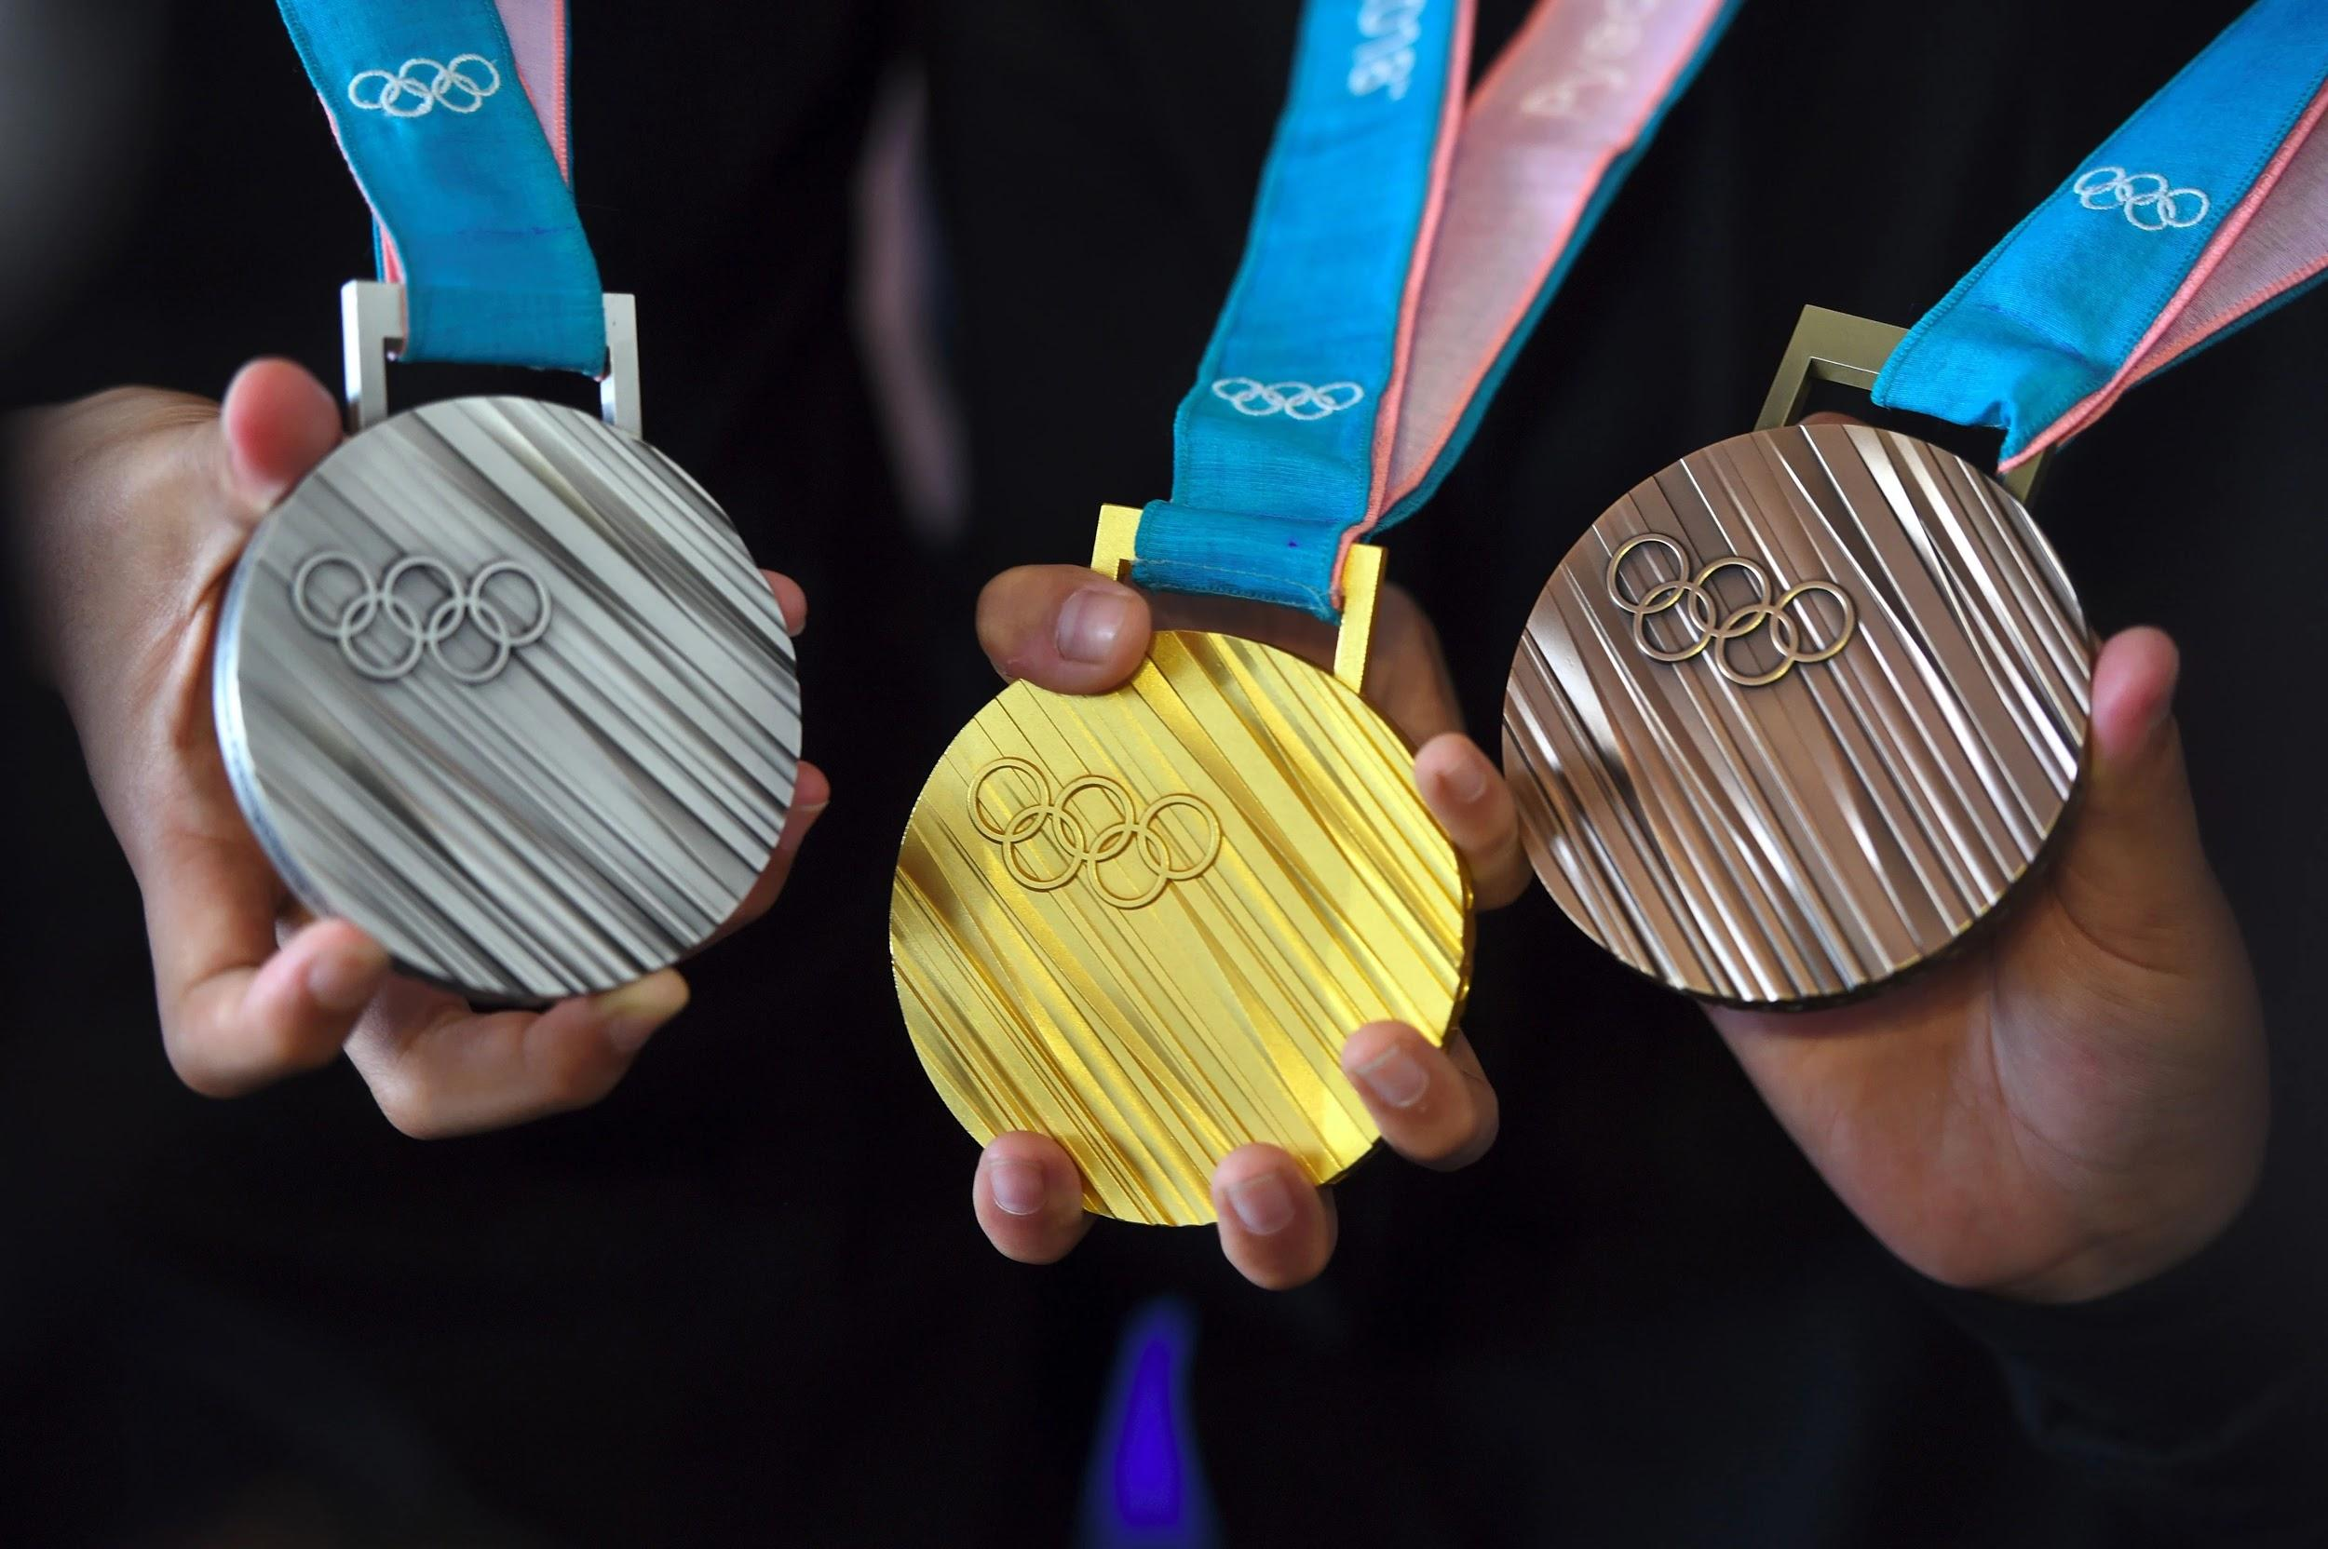
2008 Summer Olympics:
A Use Case Study on Data Product
Xinqi Wang 2003316
Abduvosid Malikov 2002824
Li Jia 2000692

Slide 2



The Project
Questions:
Which factor has a correlation with the number of Summer Olympic medals won by countries in year 2008?
GDP Per capita?
Population?
Government Expenditure on Sports?
Any fun facts about Olympic medal winners?
Data Sources:
Olympic_medals_1992-2008 (collected from Kaggle)
European government expenditure (collected from Eurostat)
Countries’ GDP Per Capita and Population (collected from The World Bank API)

Slide 3
How we answer these questions
MySQL WorkBench
Load Olympic_medals_1992-2008 data
R
Get country_code data set using the World Bank API
Knime
Build workflow and ETL data pipeline
API
Used to get GDP per capita and population data from the World Bank
Tableau
Create interactive summary graphs

Slide 4
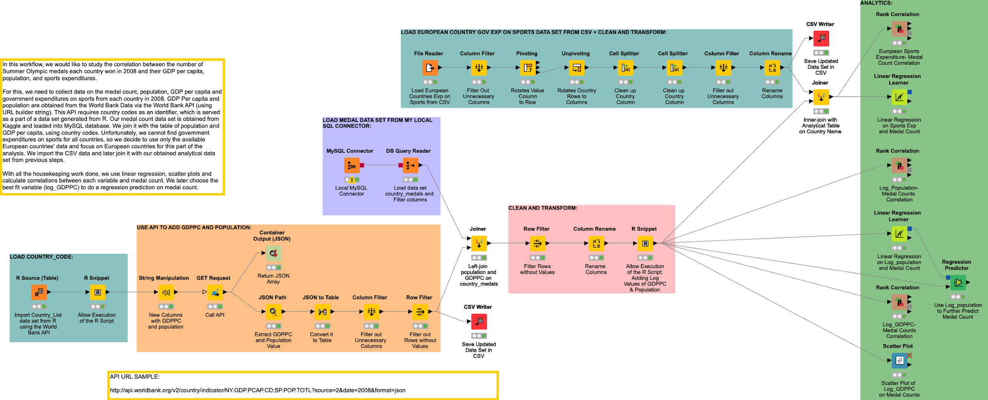
Knime Workflow

Slide 5
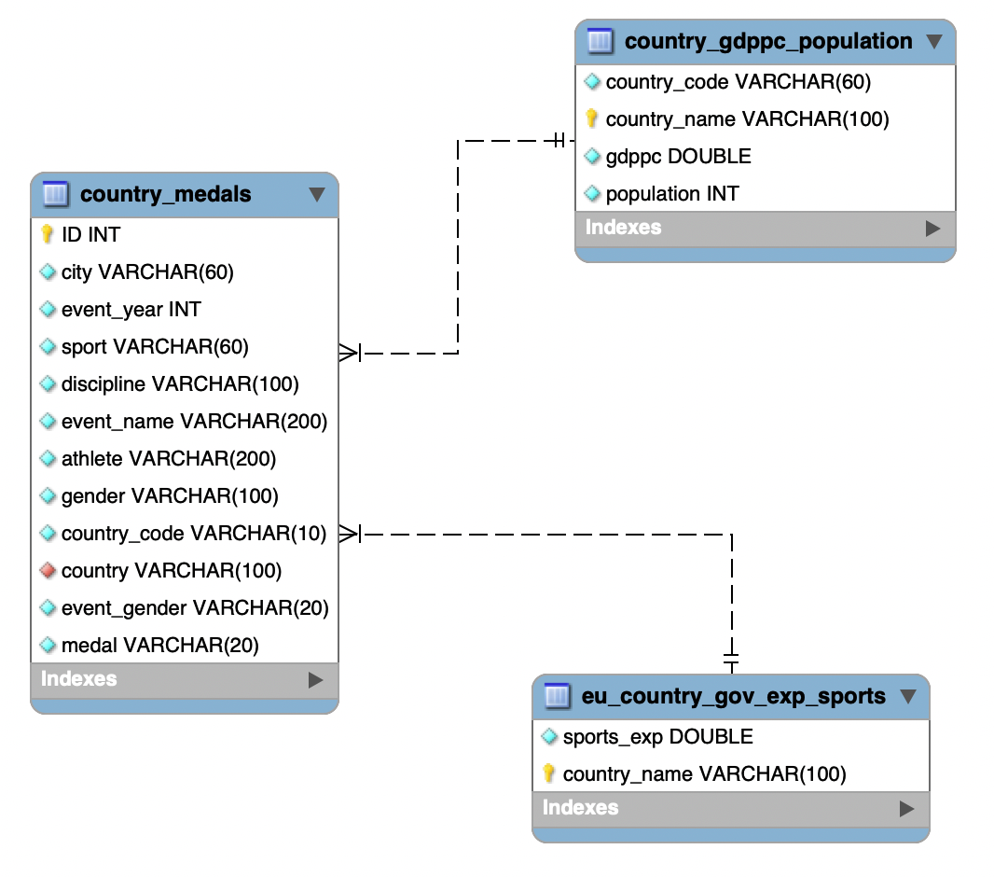
Our EER Diagram

Slide 6
R Snippet
library(WDI)
library(tidyverse)
data <- WDI_data$country
codes <- data[,2]
country_names <- data[,3]
df <- data.frame("codes" = codes, "countries" = country_names)
df <- df %>% filter(!grepl("[[:digit:]]", df$codes)) # Filter numbers and grouping observations out
drop_id <- c("EU","HK","OE")
df <- df %>% filter( !grepl( paste( drop_id , collapse="|"), df$codes ) )
fl_iso2c <- substr(df$codes, 1, 1) # drop values with certain starting char
retain_id <- c("XK","ZA","ZM","ZW") # Check again if any grouping observations
d1 <- df %>% filter( grepl( "X", fl_iso2c ) | grepl( "Z", fl_iso2c ) &
!grepl( paste( retain_id , collapse="|"), df$codes ) )
# Save observations which are the opposite of our check results
df <- df %>% filter( !( grepl( "X", fl_iso2c ) | grepl( "Z", fl_iso2c ) &
!grepl( paste( retain_id , collapse="|"), df$codes ) ) )
rm( d1 , drop_id, fl_iso2c , retain_id ) # Clear no longer needed variables
df$countries[df$codes == "TW"] <- "Taiwan" # rename Taiwan Province

Slide 7
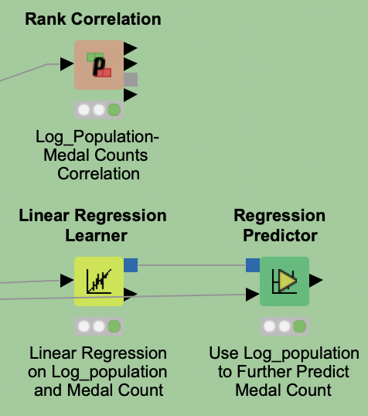
Correlation Between
Medal Count and Population
Correlation Value | P value | Degrees of Freedom
0.290730 | 0.00805 | 80
Variable | Coefficient | Std.Err | t-value | P > |t|
log_population | 14.386 | 3.077 | 4.675 | 0
intercept | -215.37 | 51.492 | -4.183 | 0

Slide 8
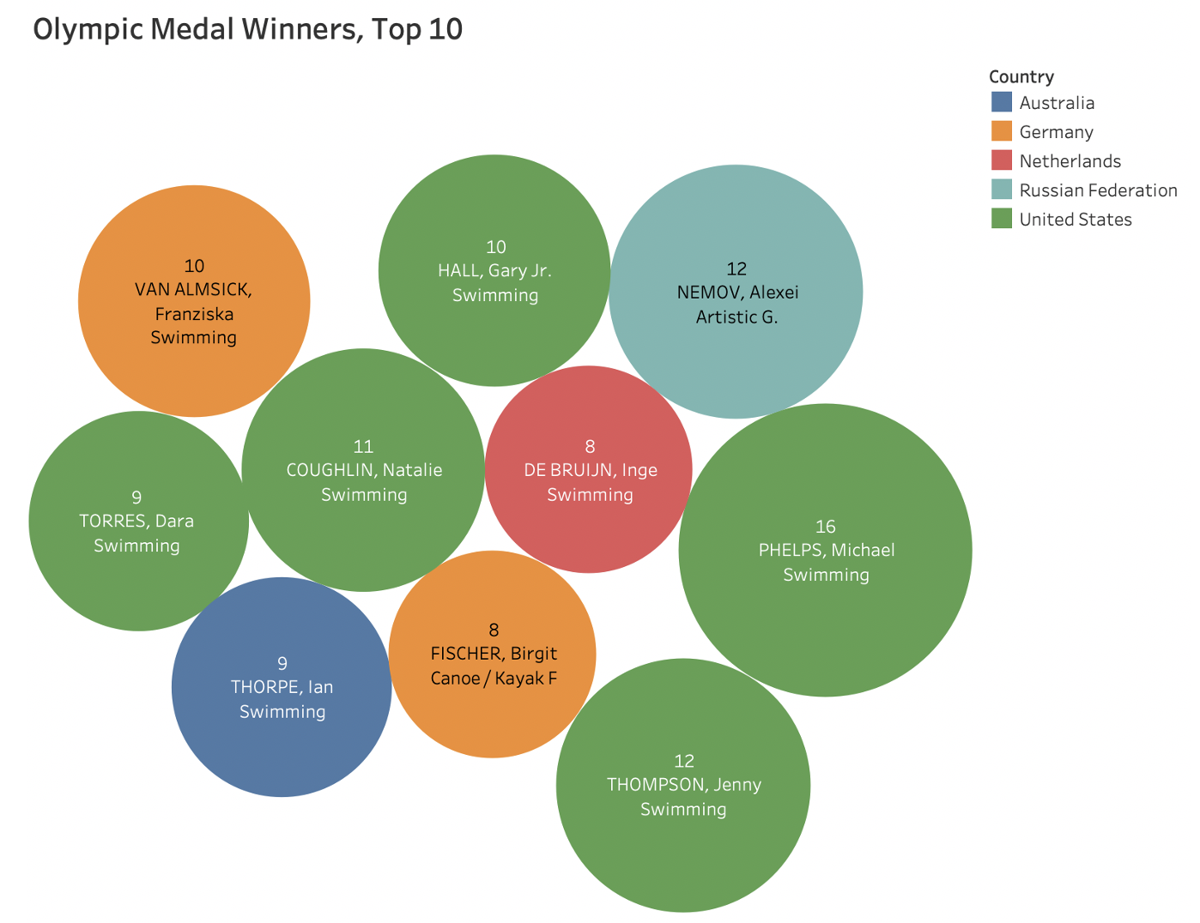
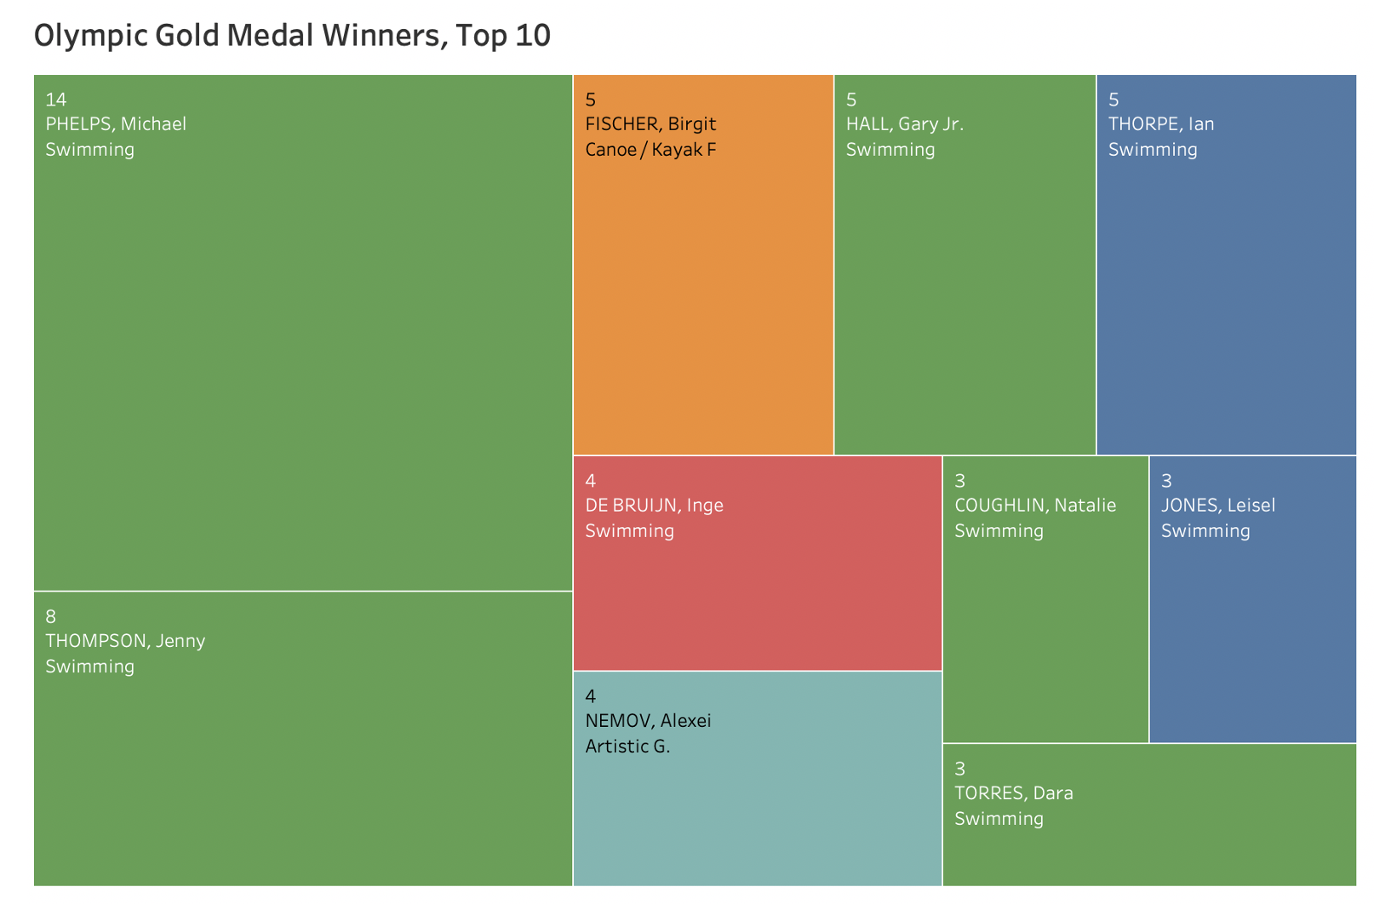
Who Won the Most Medals/Golden Medals for His/Her Country?

Slide 9
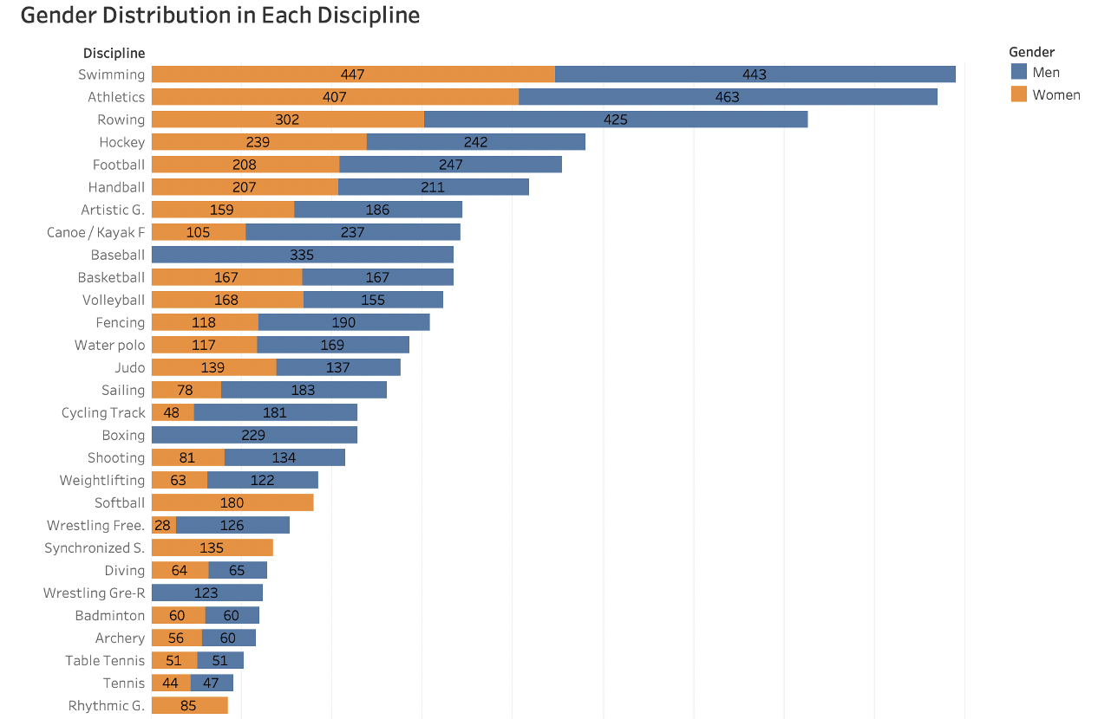
Which Discipline Has the Most Male/Female Medal Winners?

Slide 10
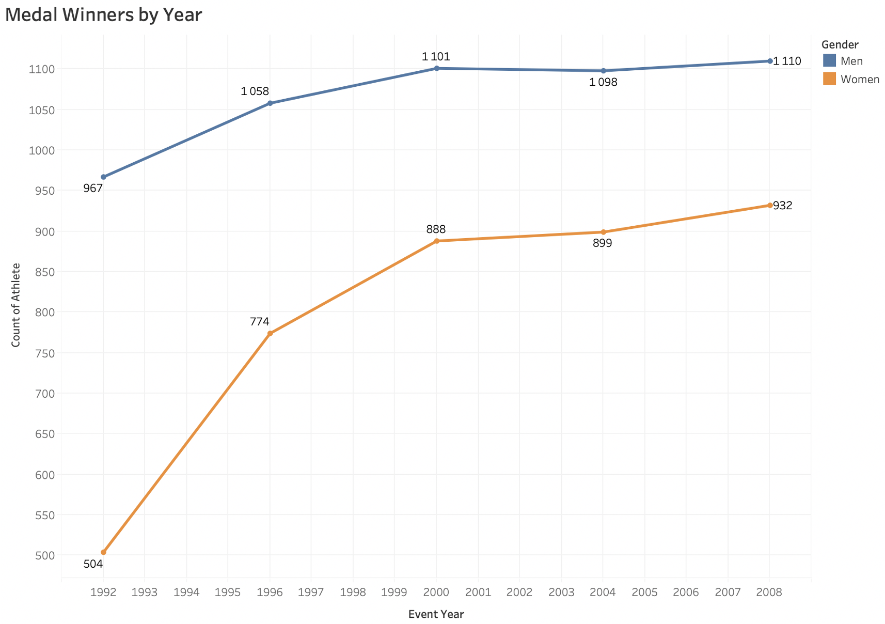
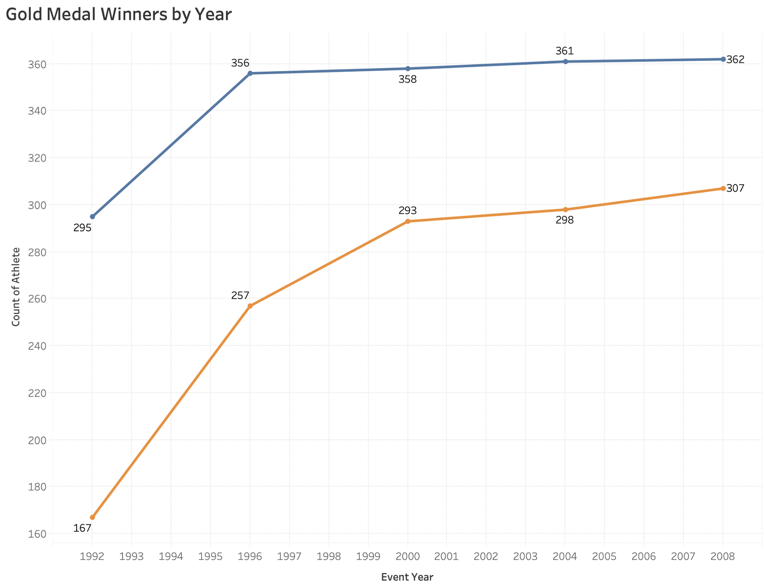
Which Year Has the Most Female Medal/Golden Medal Winner?

Slide 11
Thank you

